Slide 1
Front End Engineering-I Project
Team Details:
Rajveer (2210990711)
Rakshit (2210990712)
Ramandeep (2210990714)
Raninder (2210990715)
Faculty Coordinator: Dr . Mandeep Kaur
:
Chitkara University Institute of Engineering and Technology,
Chitkara University, Punjab

Slide 2
Table of Contents
Introduction
Problem Statement
Technical Details
Key Features
Project Highlights
Conclusion
Project Link/Reference Link

Slide 3
Introduction
This report is on the topic, ‘Survey Form’, and with the collective efforts of the team 12 members, Rajveer, Rakshit, Ramandeep(Team Leader) and Raninder, the project was made.
1. HTML (HyperText Markup Language):
HTML is the foundation of every web page. It provides the structure and content, allowing us to define headings, paragraphs, images, links, and more. By using HTML tags, we can organize and present information in a structured manner.
2. CSS (Cascading Style Sheets):
CSS is responsible for the presentation and visual styling of our web pages. It allows us to control the layout, colors, fonts, and other visual aspects. With CSS, we can transform plain HTML elements into eye-catching designs and ensure a consistent look and feel across multiple pages.
3. JavaScript:
JavaScript adds interactivity and dynamic functionality to our web pages. It is a powerful scripting language that enables us to respond to user actions, manipulate HTML elements, handle form submissions, create animations, and much more. JavaScript brings life to our static web pages by allowing them to interact with the user and respond in real-time.

Slide 4
Problem Statement
The problem at hand is the absence of a comprehensive and efficient survey form. In various domains such as market research, customer feedback, academic studies, and organizational assessments, the lack of a well-designed survey form poses significant challenges.
Without a standardized and user-friendly survey form, data collection becomes haphazard and time-consuming, leading to incomplete or inaccurate responses. Respondents often struggle to navigate confusing or overly complex survey structures, resulting in disengagement and biased data. Additionally, the absence of essential features such as skip logic, data validation, and multi-platform compatibility further hinder the effectiveness of surveys.
Therefore, there is a pressing need for an intelligently designed survey form that addresses these shortcomings and empowers researchers, organizations, and institutions to collect reliable and valuable data efficiently.

Slide 5
Technical Details
To create a survey form using basic HTML, CSS, and JavaScript, you can follow the technical details outlined below:
1. HTML Structure:
- Create an HTML form using the `<form>` element.
- Inside the form, add `<input>` elements for various types of questions (text, radio buttons, checkboxes, etc.).
- Use `<label>` elements to provide a description for each input field.
- Include a submit button using the `<button>` or `<input type="submit">` element.
2. CSS Styling:
- Use CSS to style the form elements, including fonts, colors, margins, and padding, to achieve an appealing layout.
- Apply CSS classes or IDs to specific elements to target them for styling.
3. JavaScript Functionality:
- Add event listeners to capture user actions, such as button clicks or form submissions.
- Use JavaScript to validate user inputs, ensuring that required fields are filled and data formats are correct.

Slide 6
Key Features
The key features used in making the project are given below:
Apologies for the repetition. Here are six key features of a basic survey form:
1. Questions: Include a set of well-structured and relevant questions that cover the desired information or feedback.
2. Response Options: Provide appropriate response options for each question, such as multiple-choice, rating scales, or open-ended text fields.
3. Clear Instructions: Include clear and concise instructions to guide respondents on how to answer the questions or provide feedback.
4. Submit Button: Include a "Submit" button to allow users to submit their responses once they have completed the survey.
5. Thank You Message: Display a thank you message or confirmation page after the survey is submitted to acknowledge the user's participation.
6. Responsiveness: Ensure that the survey form is designed to be responsive, adjusting its layout and formatting to fit different screen sizes, such as desktops, tablets, and mobile devices.

Slide 7
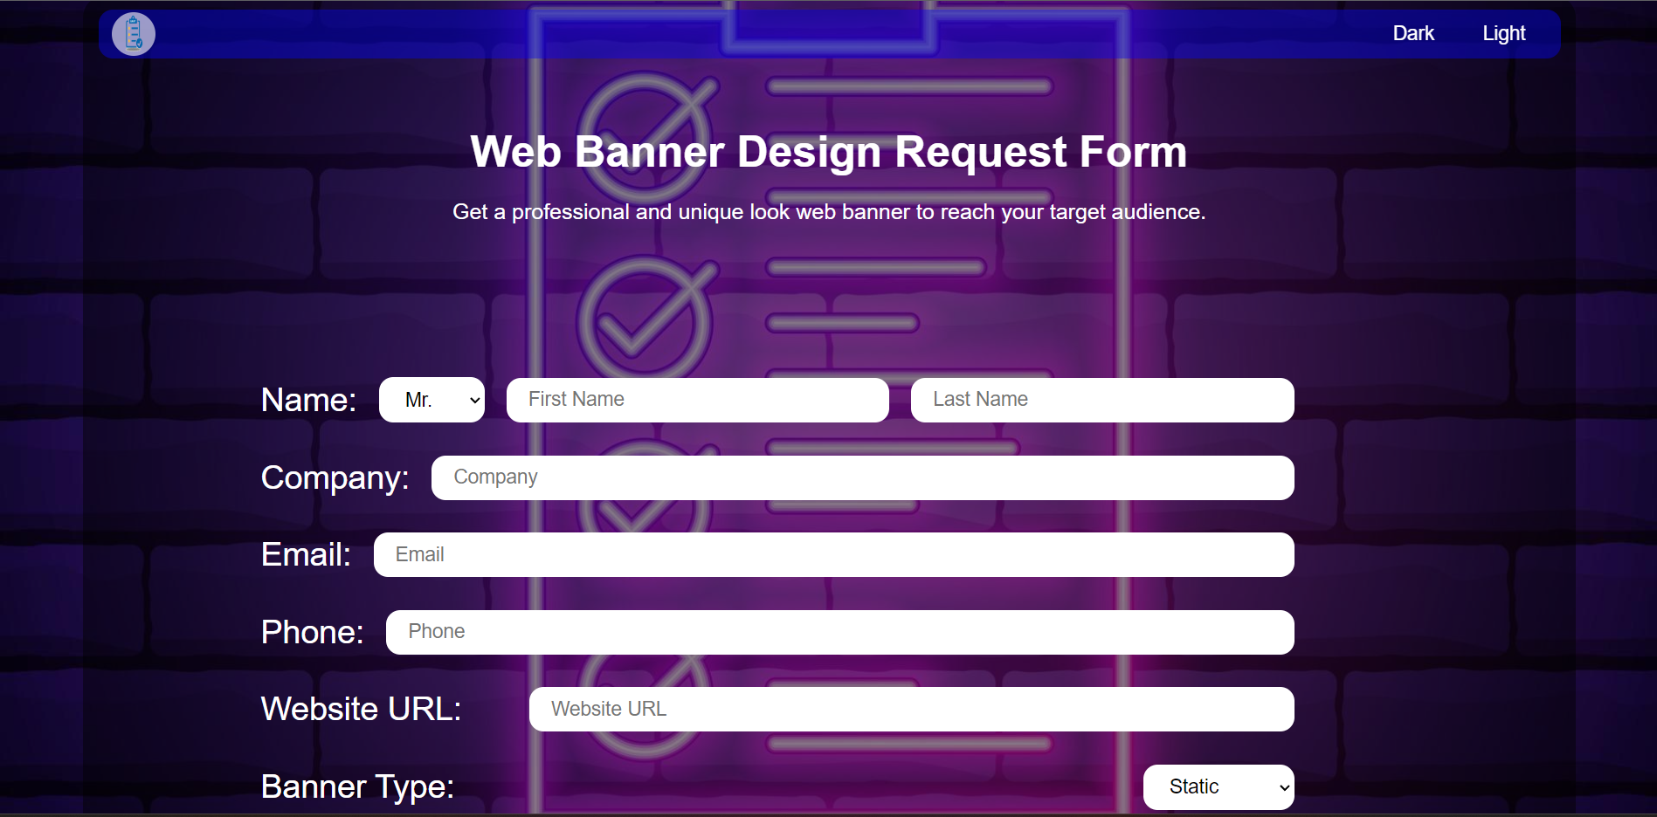
Project Highlights

Slide 8
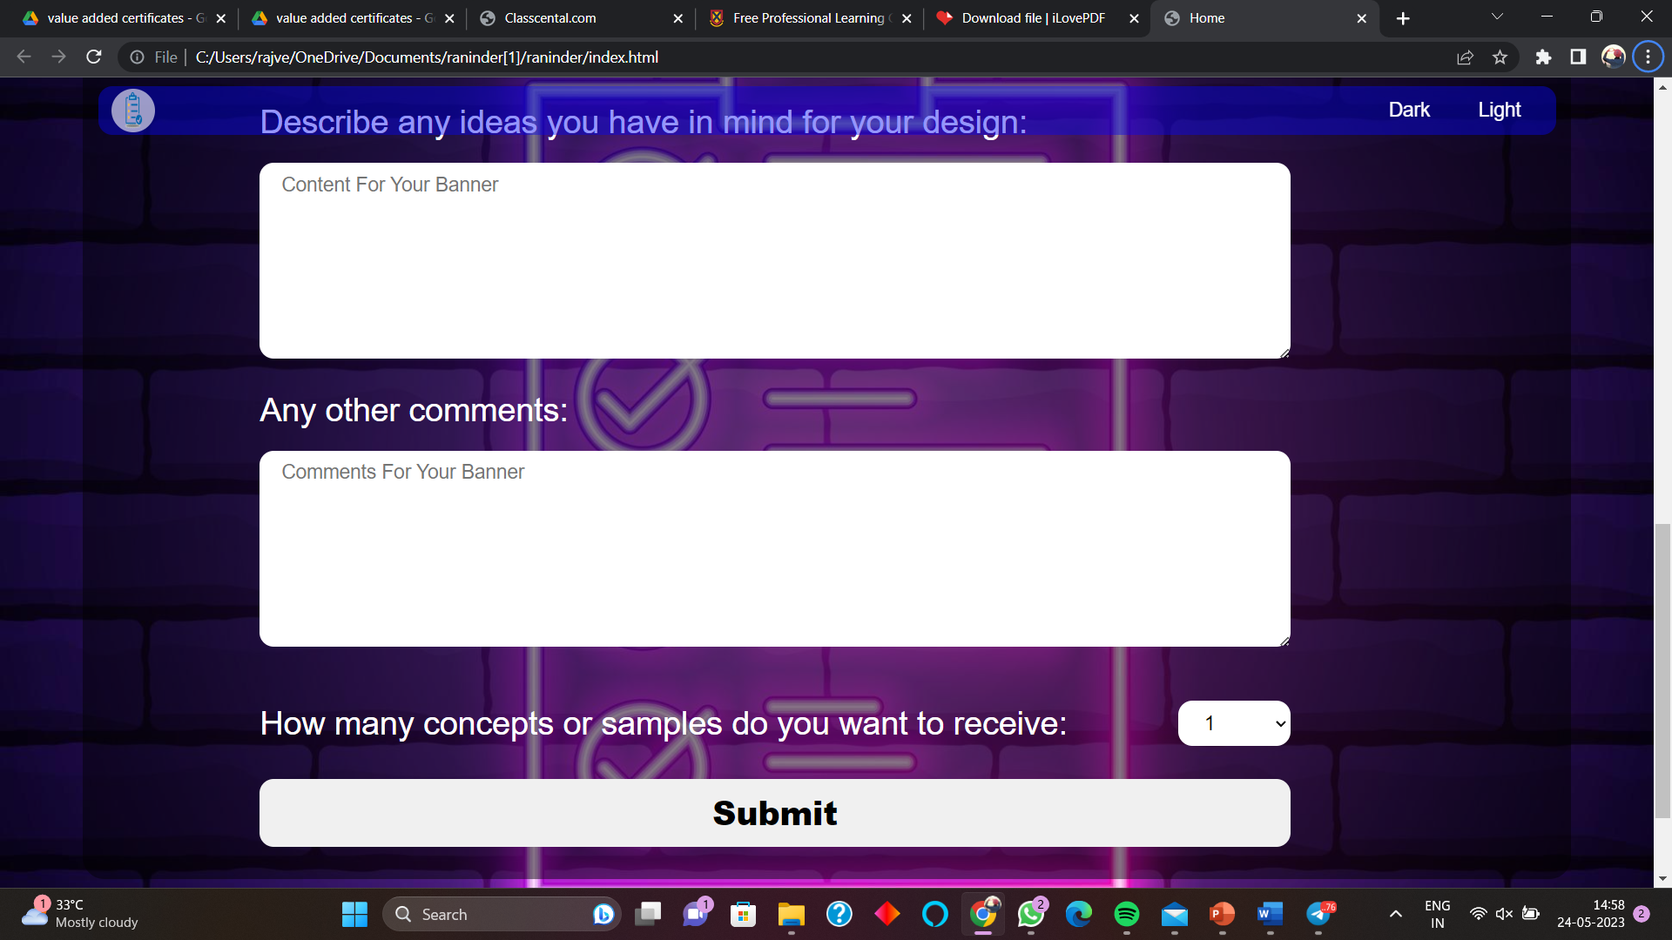
Project Highlights Continued

Slide 9
Conclusion
In conclusion, creating a survey form using HTML, CSS, and JavaScript allows you to design a user-friendly and interactive survey experience. By incorporating key features such as clear question structures, various response options, validation, navigation controls, and a responsive design, you can ensure a smooth and engaging survey process for your users.
Remember to consider the specific requirements of your survey and customize the form accordingly. With HTML, CSS, and JavaScript, you have the flexibility to create a survey form that meets your needs and provides valuable insights from your respondents.

Slide 10
Project Link/Refrence Link
https://github.com/RajveerSingh711/FEE-evalution-2.git
https://www.w3schools.com/

Slide 11


